Slide 1
Image Smoothing
Neighbourhood Operations

Slide 2
What are Neighbourhood Operations
Neighbourhood operations simply operate on a larger neighbourhood than pixel itself
Neighbourhood are mostly a rectangle around a centre pixel
This rectangle can be of any size
Origin
x
(x, y)
Neighbourhood
y
Image f (x, y)

Slide 3
Simple Neighbourhood Operations
These include:
Min: Set the pixel value to the minimum in the neighbourhood
Max: Set the pixel value to the maximum in the neighbourhood
Mean: Set the pixel value to the neighbourhood mean
Weighted Mean: Set pixel value to weighted neighbourhood mean

Slide 4
The Spatial Filtering Process
Origin
x
a
b
c
r
s
t
d
e
f
*
u
v
w
g
h
i
x
y
z
Original Image Pixels
Filter
Simple 3*3 Neighbourhood
e
3*3 Filter
e_{processed} = v*e + r*a + s*b + t*c + u*d + w*f + x*g + y*h + z*i
y
Image f (x, y)
The above process is repeated for each and every pixel to get filtered image

Slide 5
Smoothing Spatial Filters
One of the simplest spatial filtering operations we can perform is a un-weighted smoothing process
Simply average all of the pixels in a neighbourhood around a central value
Especially useful in removing noise from images but may lead to edge blurring
Also useful for highlighting gross detail
¹/₉ | ¹/₉ | ¹/₉
¹/₉ | ¹/₉ | ¹/₉
¹/₉ | ¹/₉ | ¹/₉
Simple Averaging Filter

Slide 6
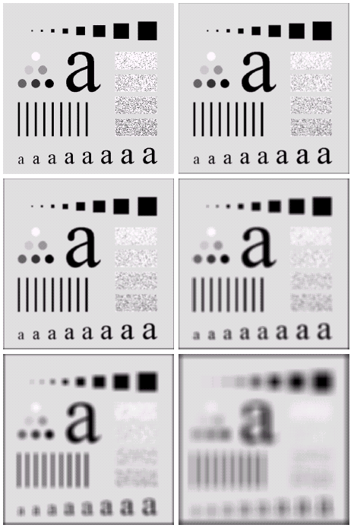
Image Smoothing Example
The image at the top left is an original image of size 500*500 pixels
The subsequent images show the image after filtering with an un-weighted averaging filter of increasing rectangular filter sizes
3, 5, 9, 15 and 35
Notice how detail begins to disappear with increase in neighbourhood size

Slide 7
Weighted Smoothing Filters
More effective smoothing filters can be generated by allowing different pixels in the neighbourhood different weights in the averaging function
Pixels closer to the central pixel are more important
Often referred to as a weighted averaging
Less blurring compared to un-weighted filter
¹/₁₆ | ²/₁₆ | ¹/₁₆
²/₁₆ | ⁴/₁₆ | ²/₁₆
¹/₁₆ | ²/₁₆ | ¹/₁₆
Weighted averaging filter

Slide 8
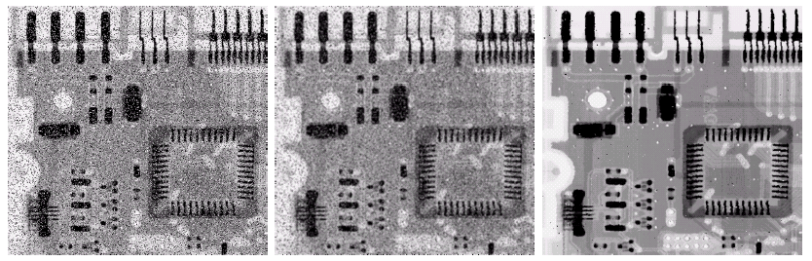
Averaging Filter Vs. Median Filter Example
Original Image With Noise
Image After Averaging Filter
Image After Median Filter
Filtering is often used to remove noise from images
Sometimes a median filter works better than an averaging filter

Slide 9
Strange Things Happen At The Edges!
However strange things happen at the edges of an image since we are missing pixels to form a neighbourhood
Origin
x
e
e
e
e
e
e
e
y
Image f (x, y)

